Slide 1
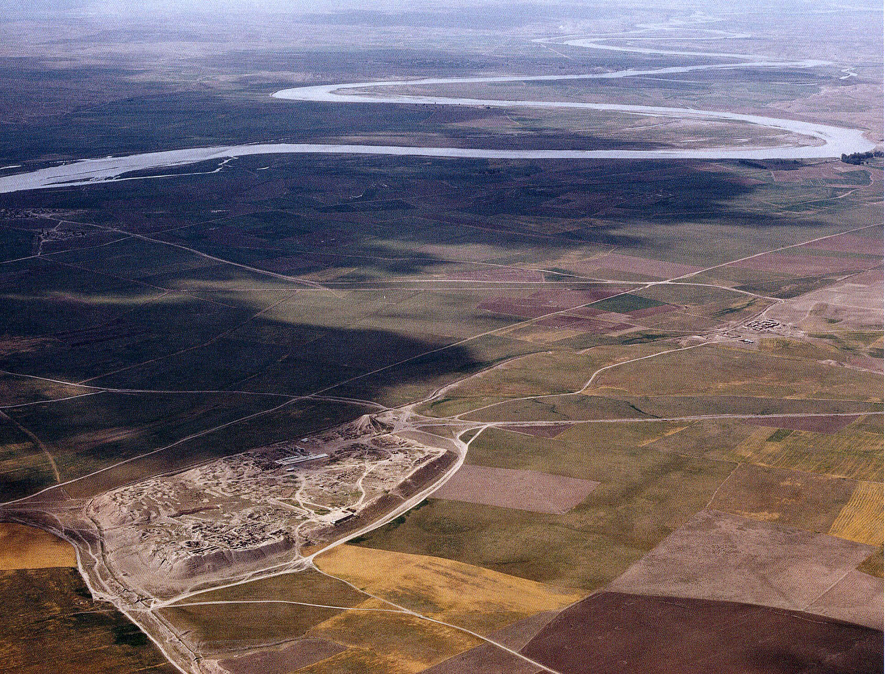

Water and Early Civilization in Mesopotamia
Jason Ur
John L. Loeb Associate Professor
of the Social Sciences
Department of Anthropology
Harvard University
Water in Context: Exploring water in the Middle East region through GIS mapping and cross-disciplinary perspectives – 28 September 2012
Notes:
Signif of water in anc societies generally
Signif of water in ME in particular
Wittfogel Hydraulic Hypothesis
Environment and teaching
Space and teaching

Slide 2
Foci
“Greater Mesopotamia”
Water at a Regional Scale
Notes:
“greater mesop” but could talk about, e.g., Egypt, other riverine civ
Water at broad spatial scale, regions
Mostly as an economic resource

Slide 3
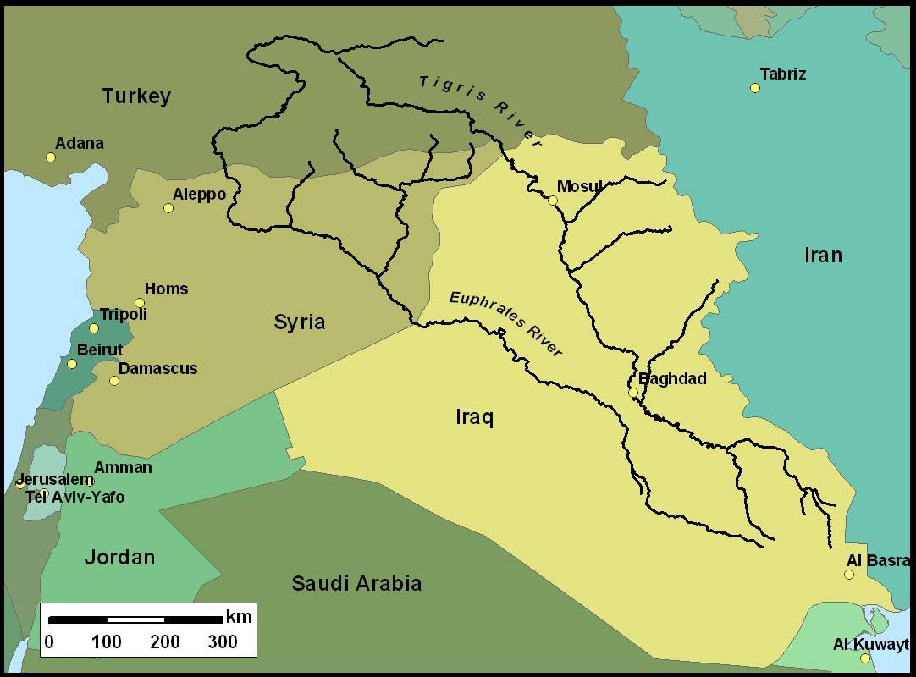
Modern Mesopotamia
Notes:
Geographical Framework (modern political boundaries)
Kurdistan

Slide 4
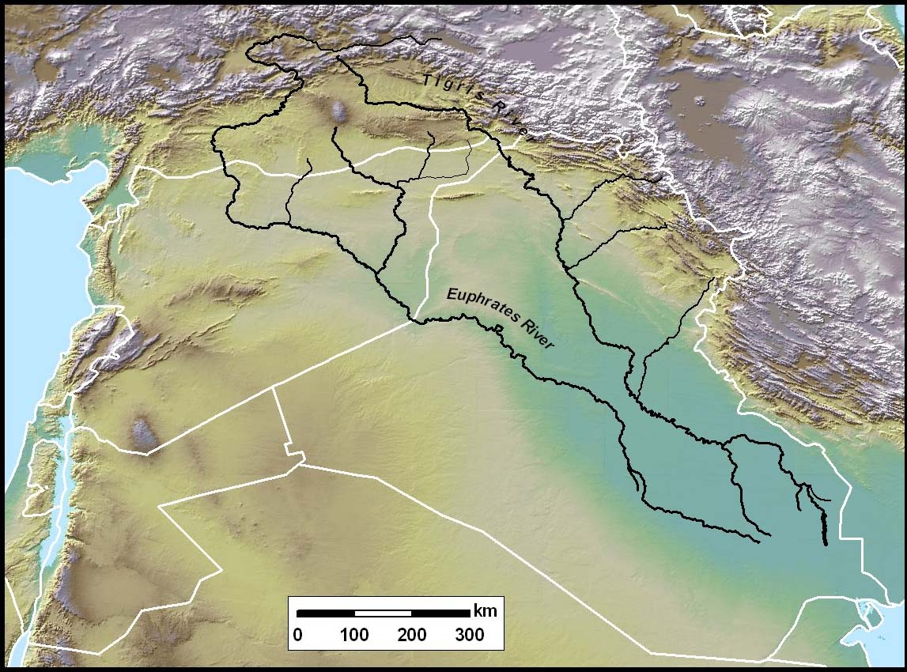
Mesopotamia: Geography
Notes:
Geography: Zagros Mts
Rainfall patterns: from W, hit mts
Tigris and Euphrates

Slide 5
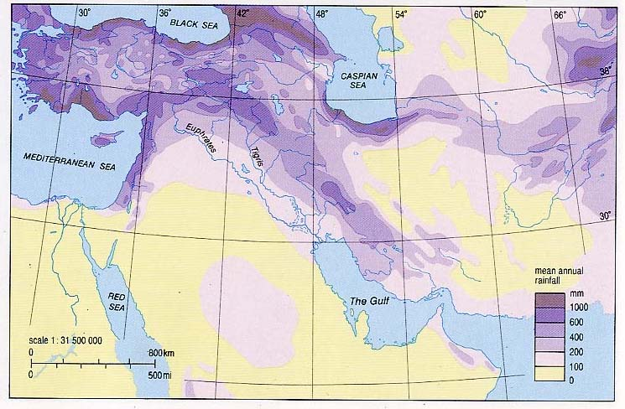
Rainfall in the Middle East
Notes:
Distribution of rainfall
“Fertile Crescent”

Slide 6
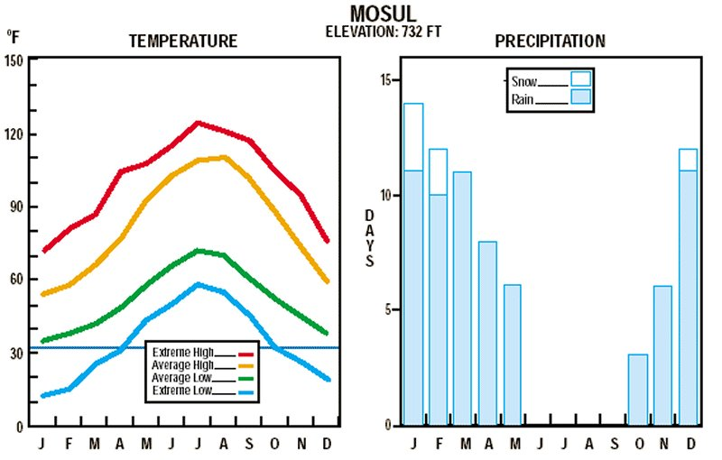
Seasonality of Temperature & Rainfall
(Mosul, Northern Mesopotamia)
Notes:
High seasonality: all rain in winter
Also year-to-year variability

Slide 7
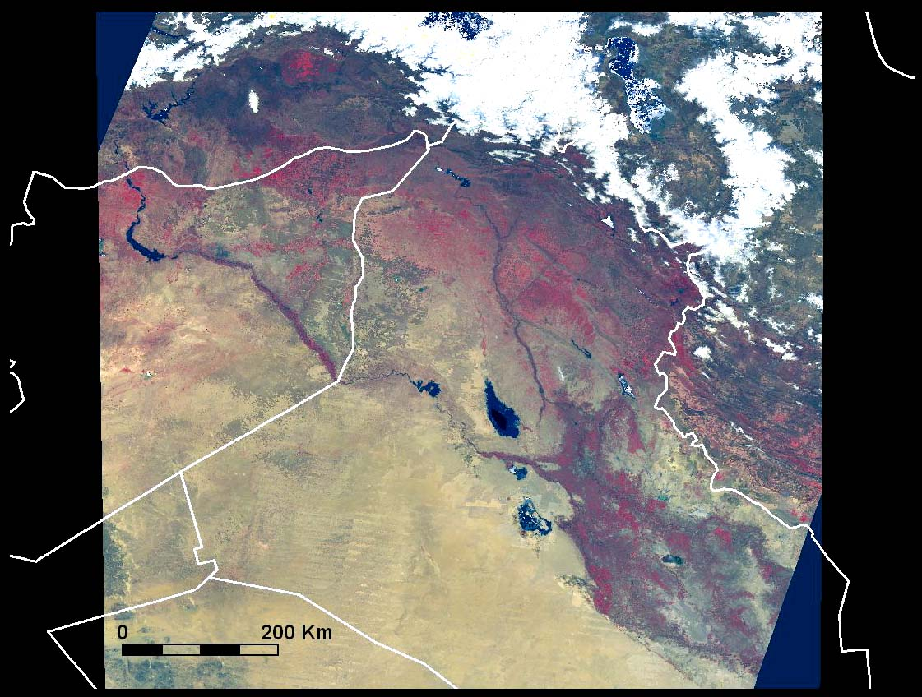
Mesopotamia
April 2003 (MODIS Image)
Red = Vegetation (agriculture)
Assyria
Northern Mesopotamia
Uruk
Southern Mesopotamia
Notes:
Difference between N and S Mesopotamia

Slide 8
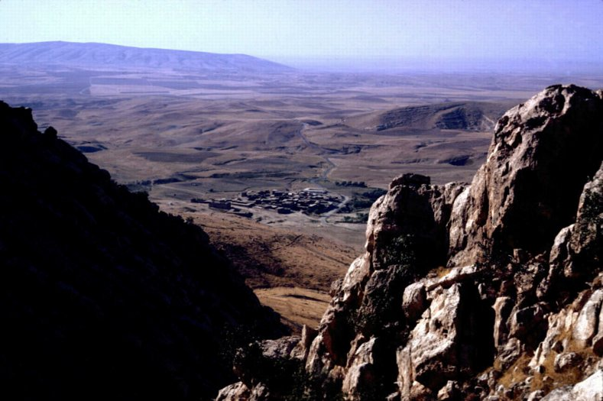
Northern Mesopotamia: Zagros Foothills
Notes:
Foothills: small valleys, springs, small areas of cultivable land
Kurdistan

Slide 9
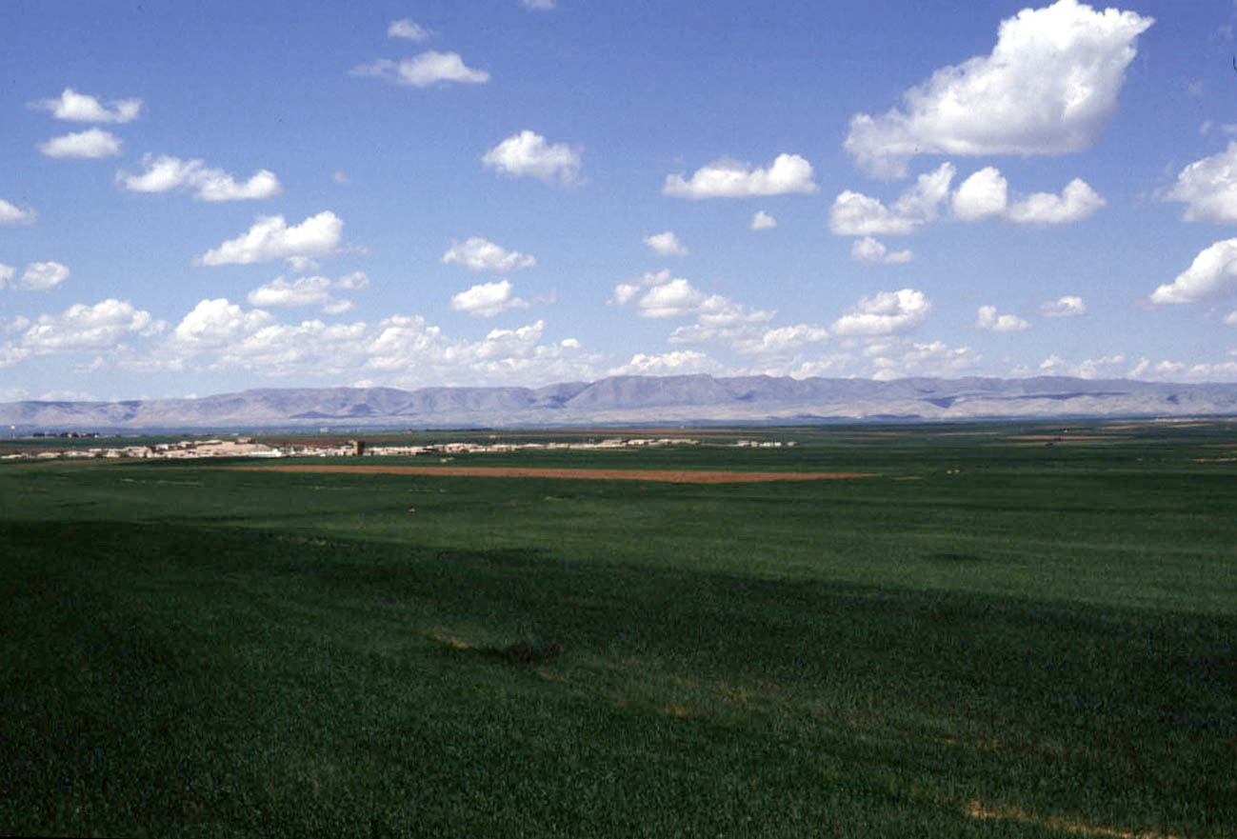
Northern Mesopotamia: Rain-Fed Agriculture
Notes:
Relatively high annual rainfall
Slopes steep, rivers deep

Slide 10
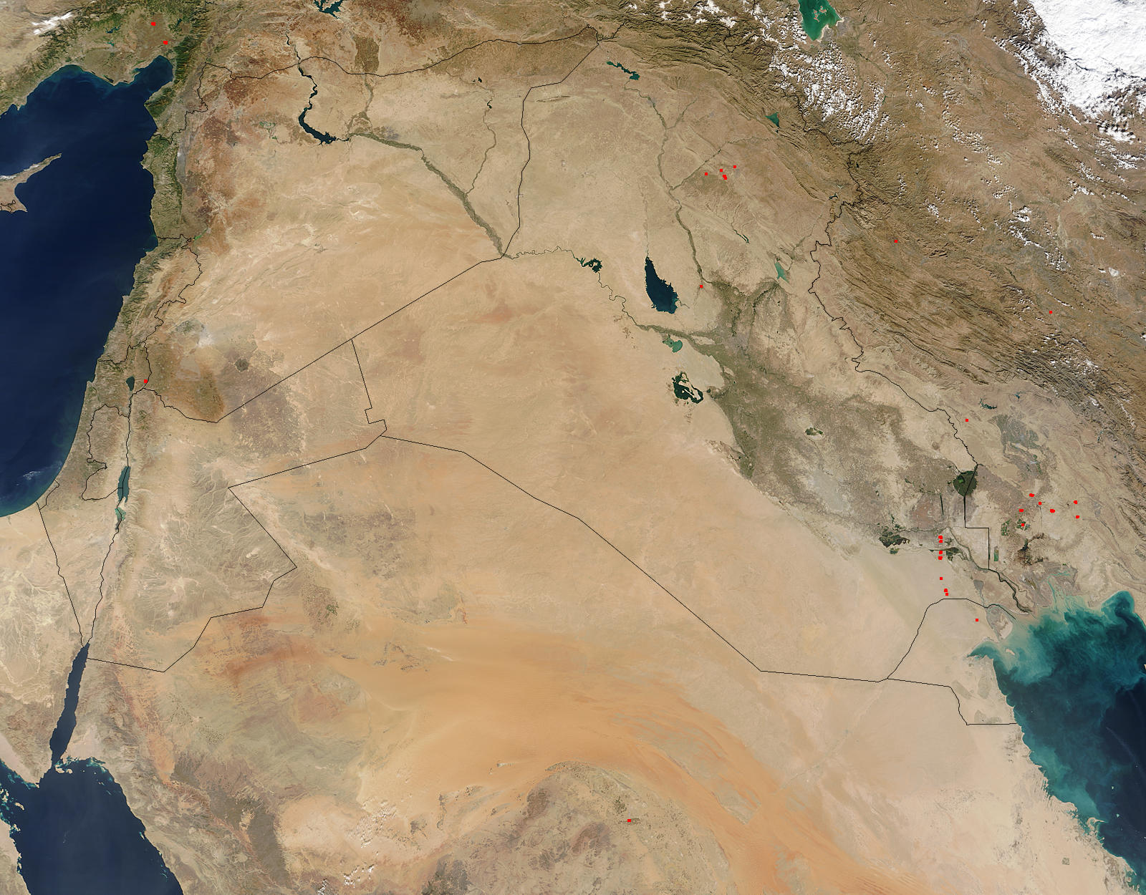
Mesopotamia
3 Nov 2003
Notes:
Southern Mesopotamia
VERY low rainfall
Very flat (less than 40 m from Baghdad to Gulf)

Slide 11
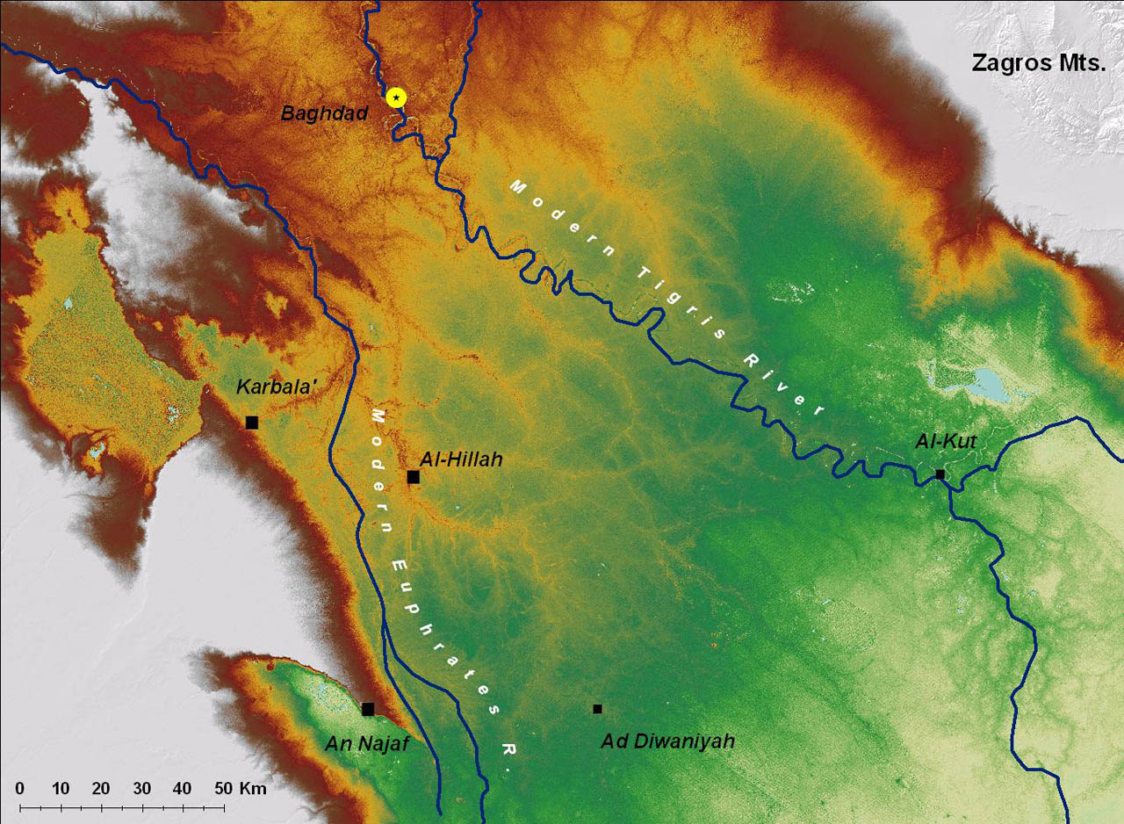
Topography of
Southern Mesopotamia
(Relict Levees)
Notes:
Levee formation

Slide 12
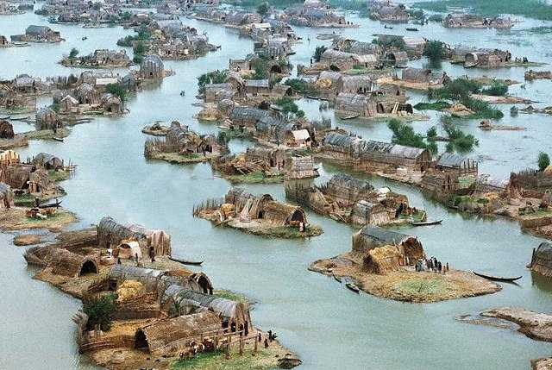
Marshes of southern Mesopotamia
Notes:
At the SE end, the Mesop marshes

Slide 13
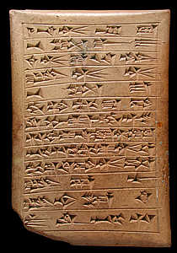
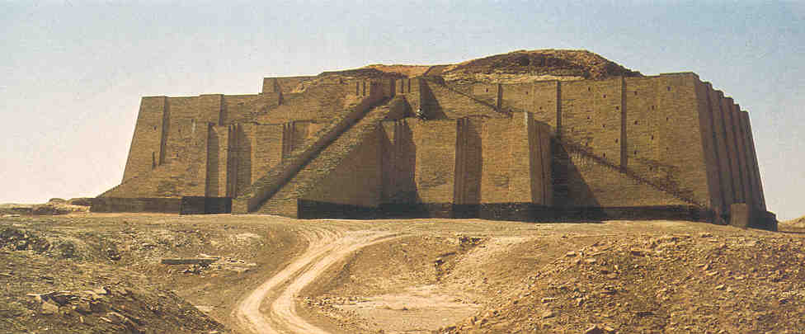
Water and Mesopotamian Origins ca. 3000-1500 BC
Notes:
Look at two phases of Mesop Civ: Early (Sumerian) and later (Assyrian)
Sumerian Civ described

Slide 14
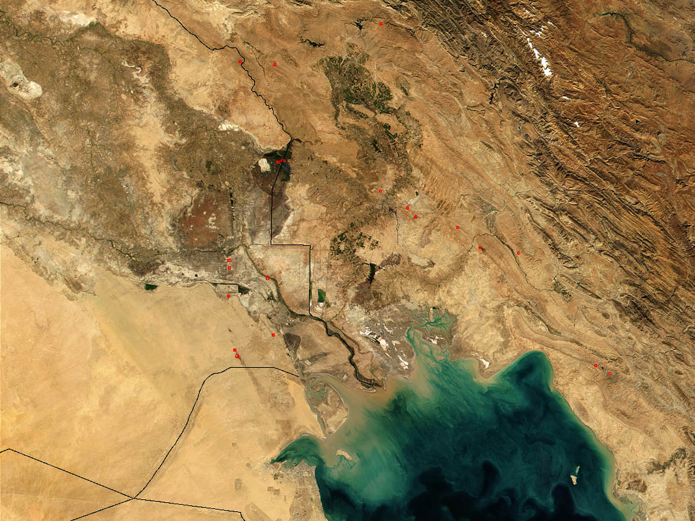
Head of the Gulf?
Uruk
Notes:
Where was the head of the gulf in the past?
Why it matters for early civ

Slide 15
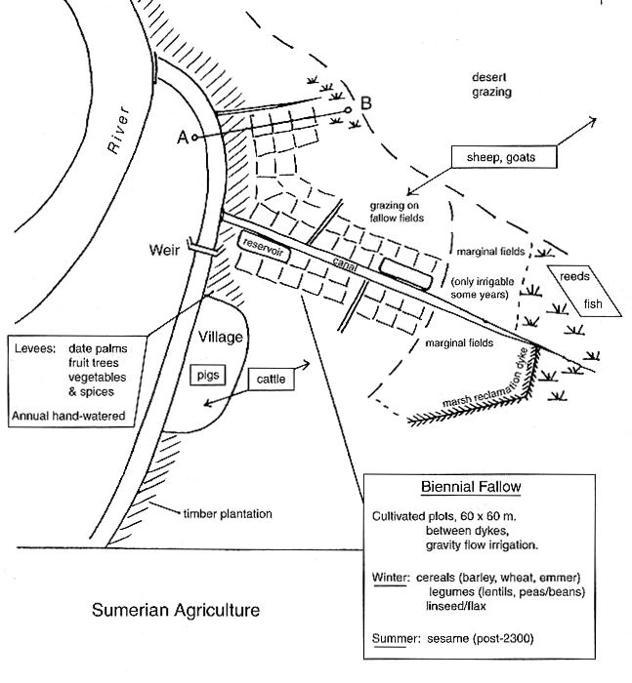
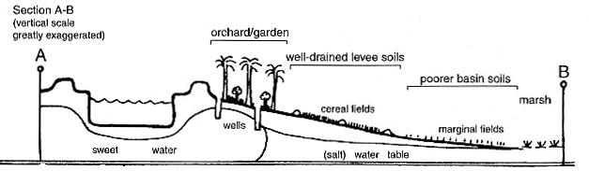
Irrigation in Southern Mesopotamia
Notes:
Traditional irrigation described
Water distribution

Slide 16
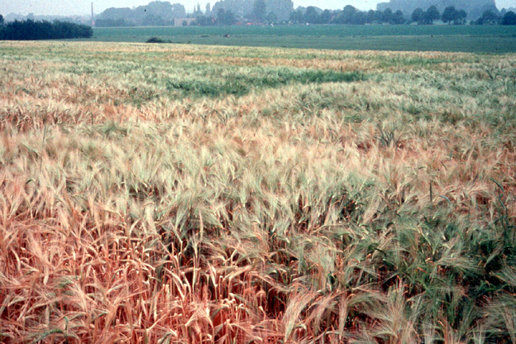
Why irrigate?
Quantity of water
Timing of water
Higher and more reliable yields
Notes:
What does irrigation do?
Increase of amount water for crops (ameliorate drought etc.)
Control timing of water applications
Result: higher and more reliable yields

Slide 17
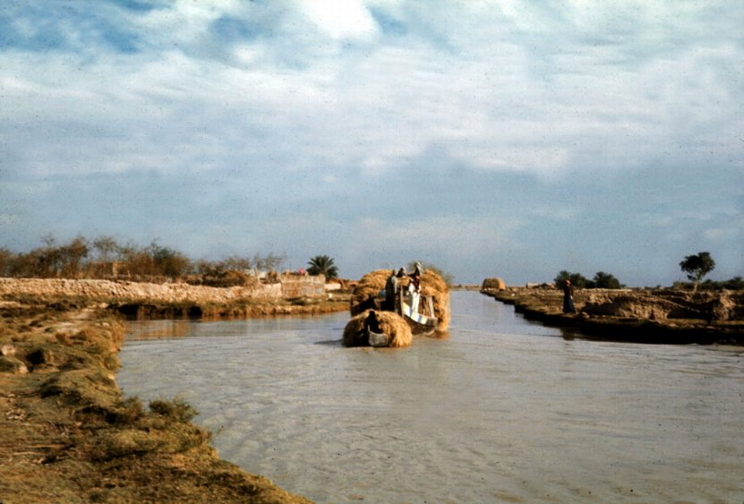
Water Transport
Notes:
Low friction means of transport, for bulk goods
Superhighways of Mesop civ

Slide 18
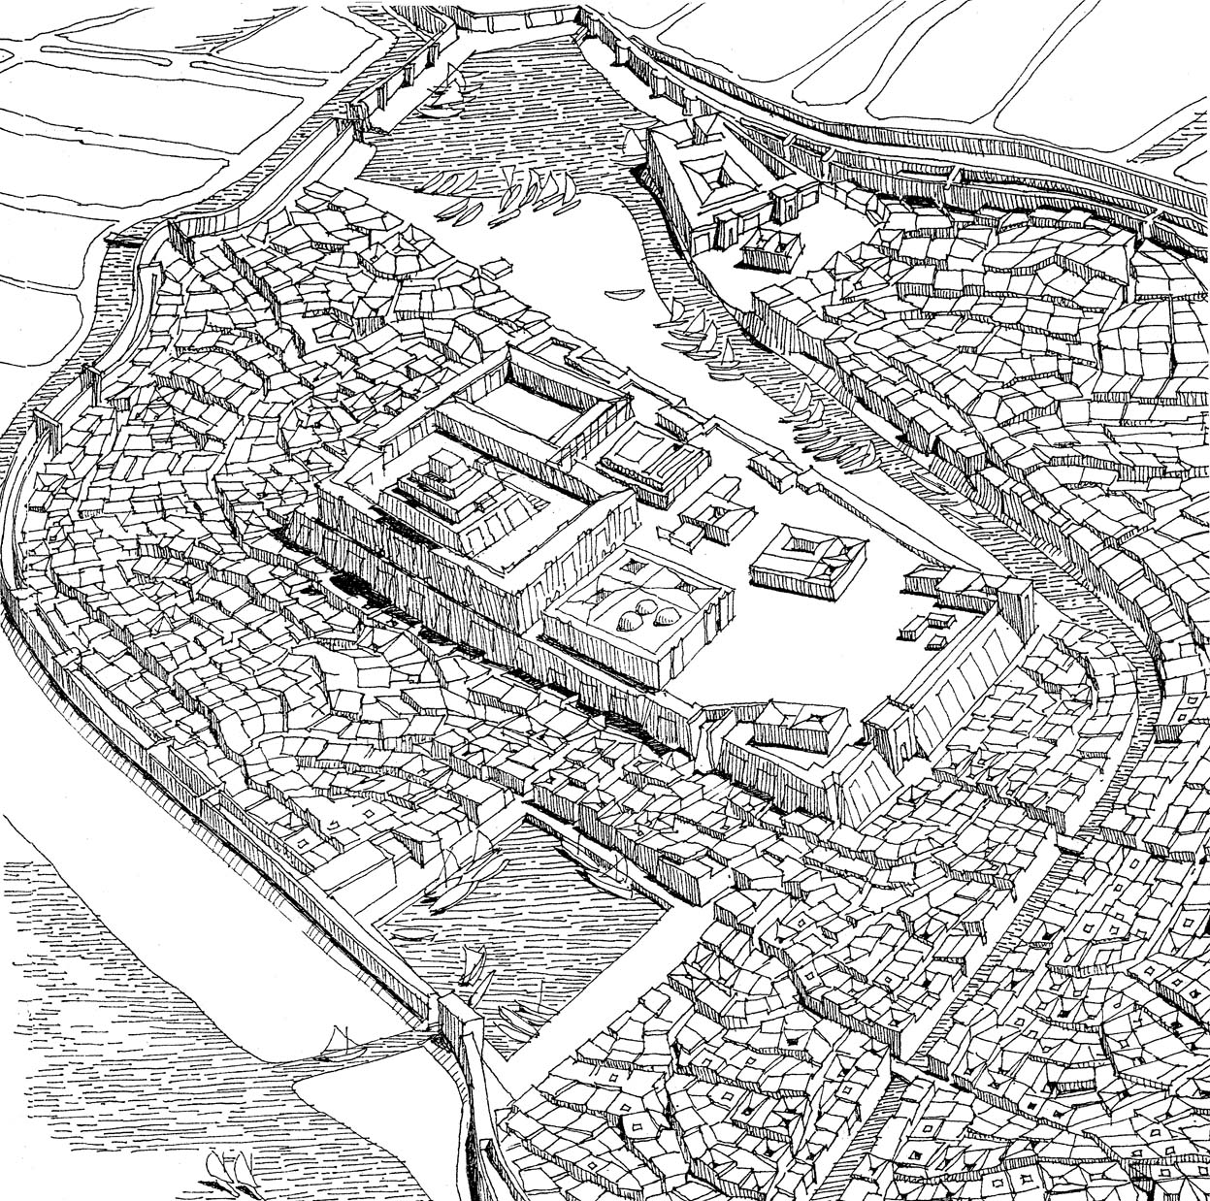
Mesopotamian
Cities
City of Ur, ca. 1700 BC
Notes:
Together, these elements enable population nucleation (i.e., urbanism)
Highly durable

Slide 19
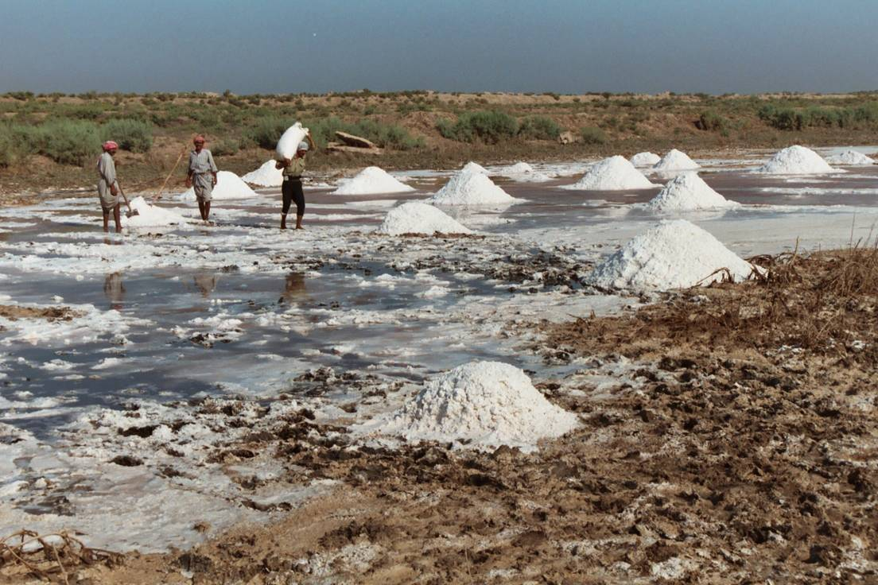
Salinization through Over-Irrigation
Notes:
Danger of salinization
Irrig water contains suspended salts
Must be flushed out of soils
Over irrig keeps water table high, salts in root zone, low productivity

Slide 20
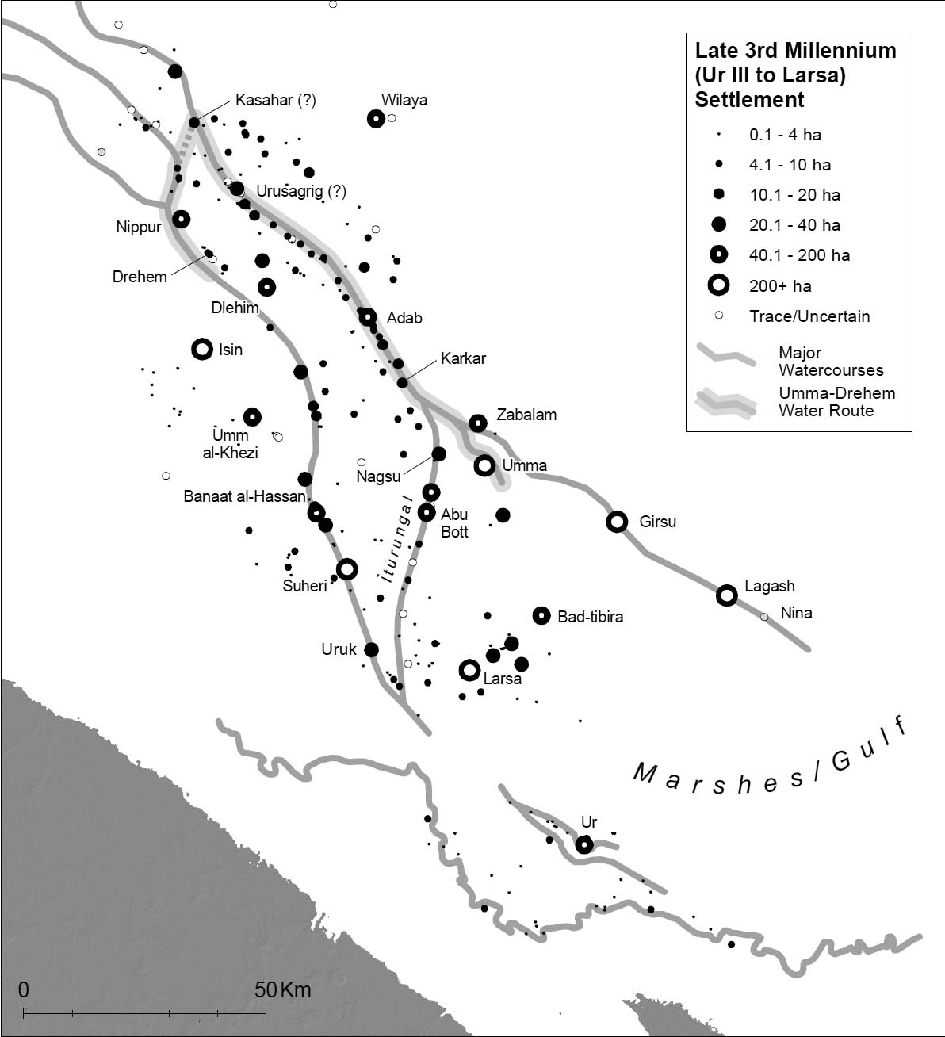
Settlement and Watercourses ca. 2000 BC
Mesopotamia as a Riverine Civilization
Notes:
Rivers and canals defined spatial patterns of settlement

Slide 21
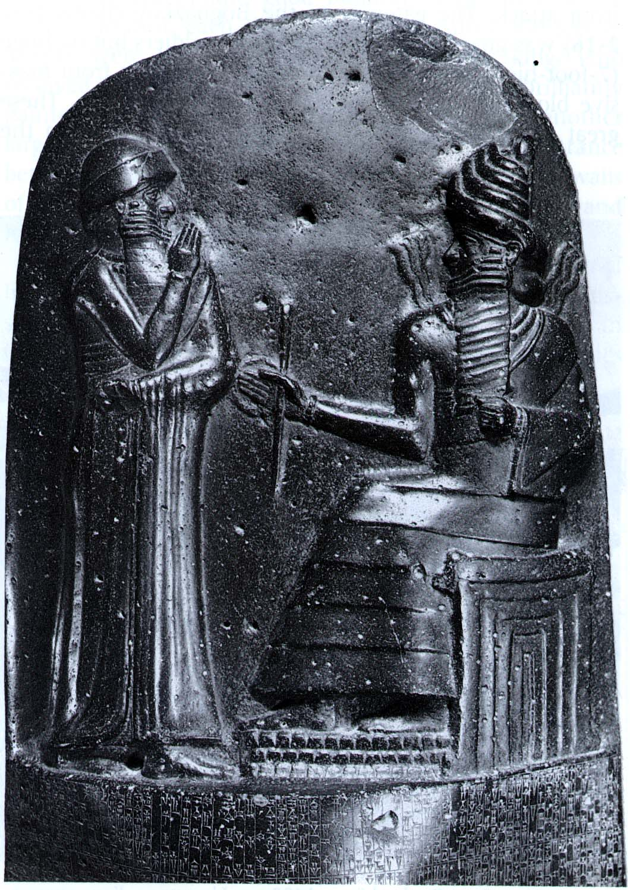
Water and Kings
Hammurabi and Shamash, the Sun God
Notes:
Irrigation as a royal task
Wittfogel hydraulic hypothesis disproven

Slide 22
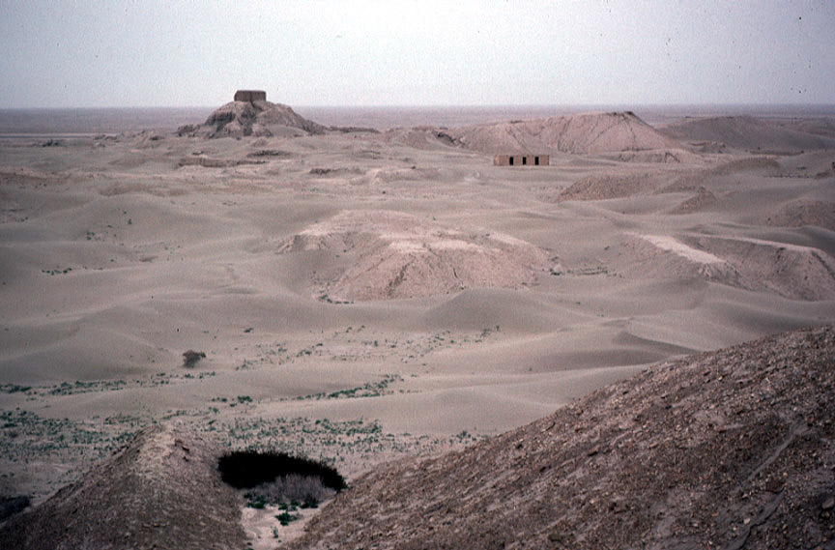
The Dynamic Environment
Notes:
Rivers Move! Mississippi, Euphrates, etc.

Slide 23
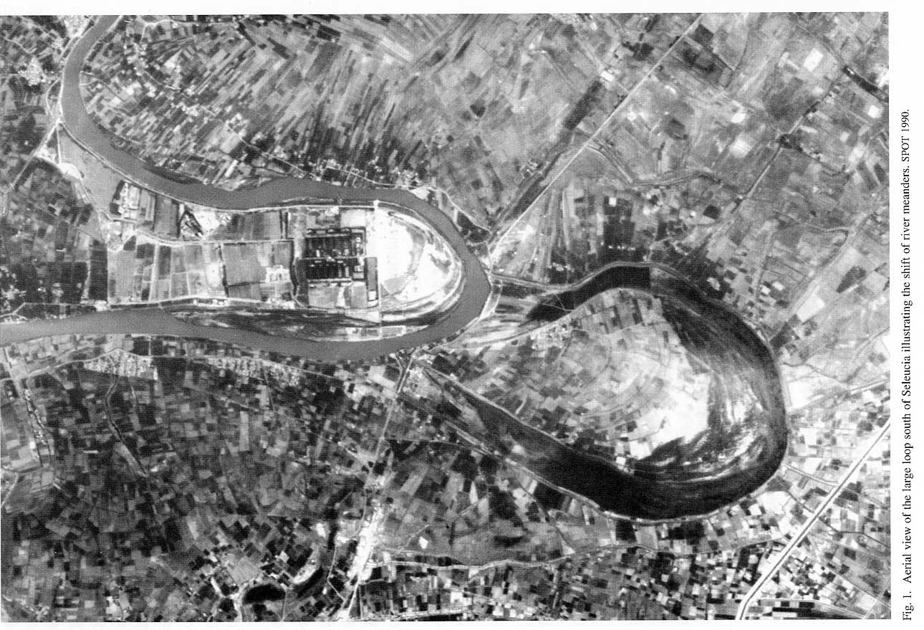
Small Fluctuations: Oxbows

Slide 24
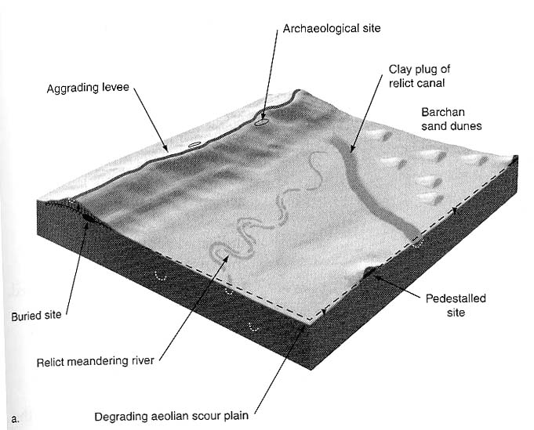
Levee Formation
Notes:
Much larger structural changes
Because of levee formation

Slide 25
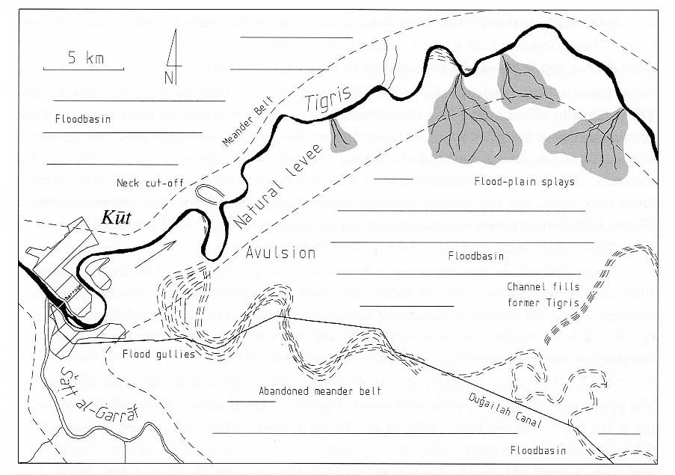
Dramatic Shifts: River Avulsions

Slide 26
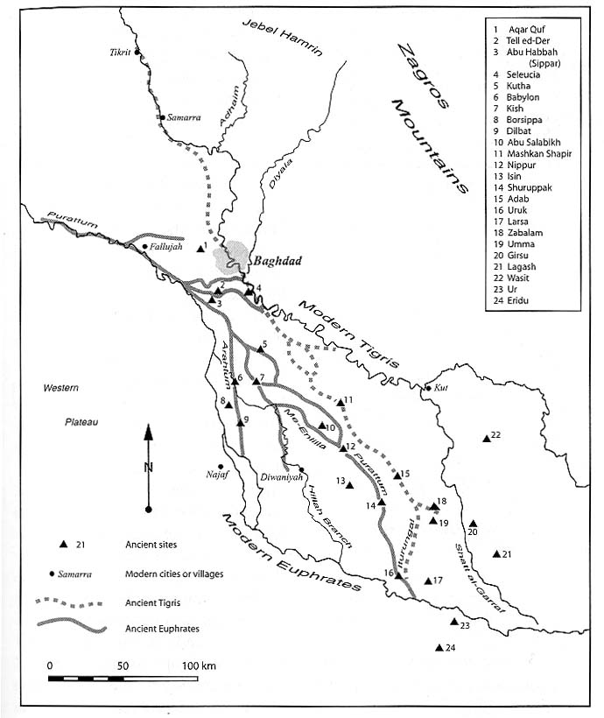
Abandonment of the Central Floodplain
Notes:
Humans countering river mobility
Humans causing river mobility

Slide 27
Water in Northern Mesopotamia
Northern Mesopotamia
Assyria
Uruk
Notes:
Rainfed agriculture
Risks/dought etc.
Urban rises and collapses

Slide 28
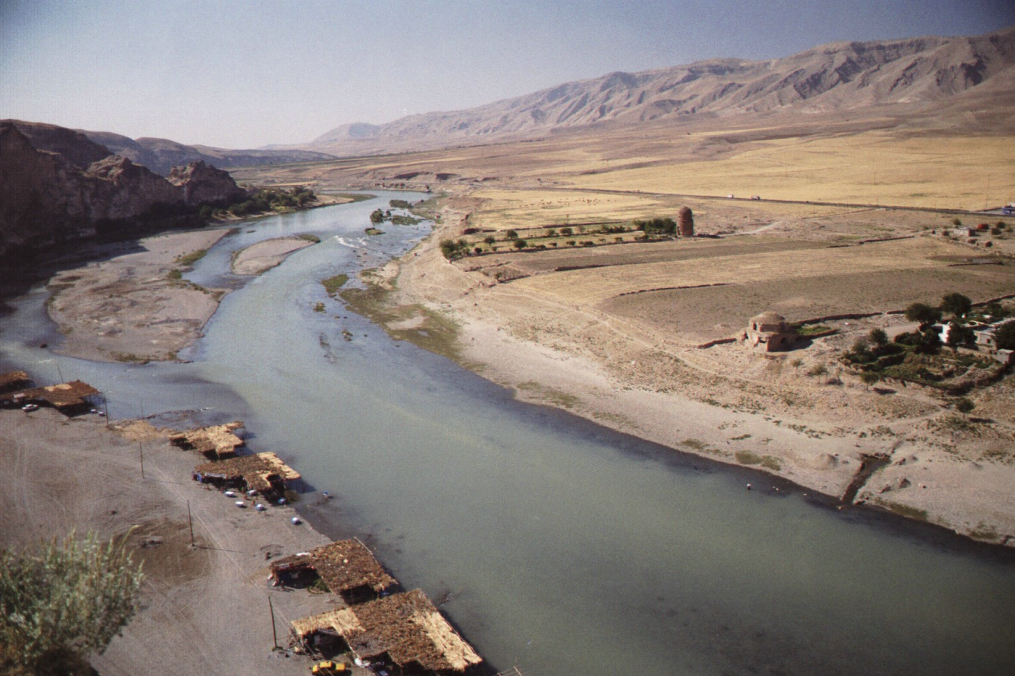
Upper Tigris River Valley
Notes:
CHALLENGES TO water manipulation
Gradient, downcutting rivers, terraces
Only with very large and powerful states does irrig appear

Slide 29
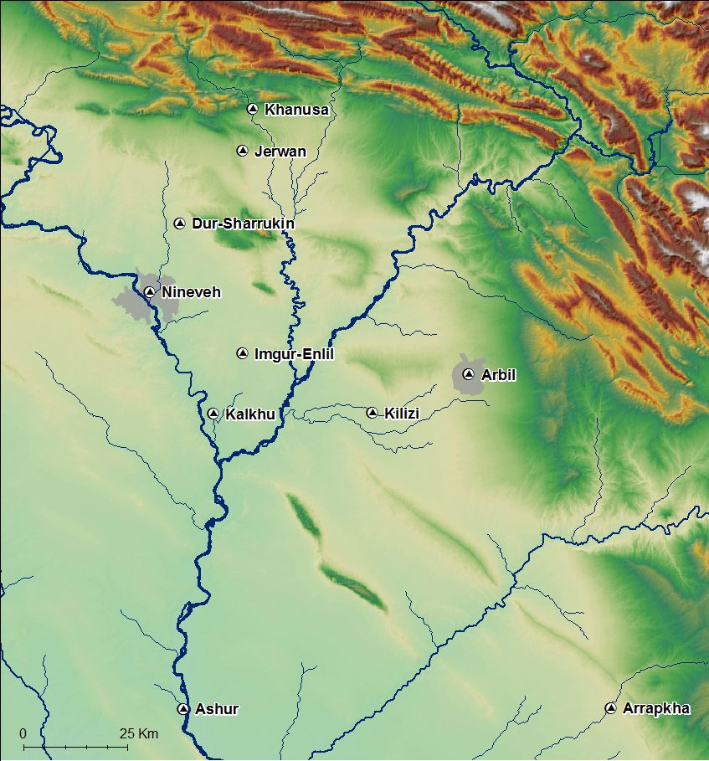
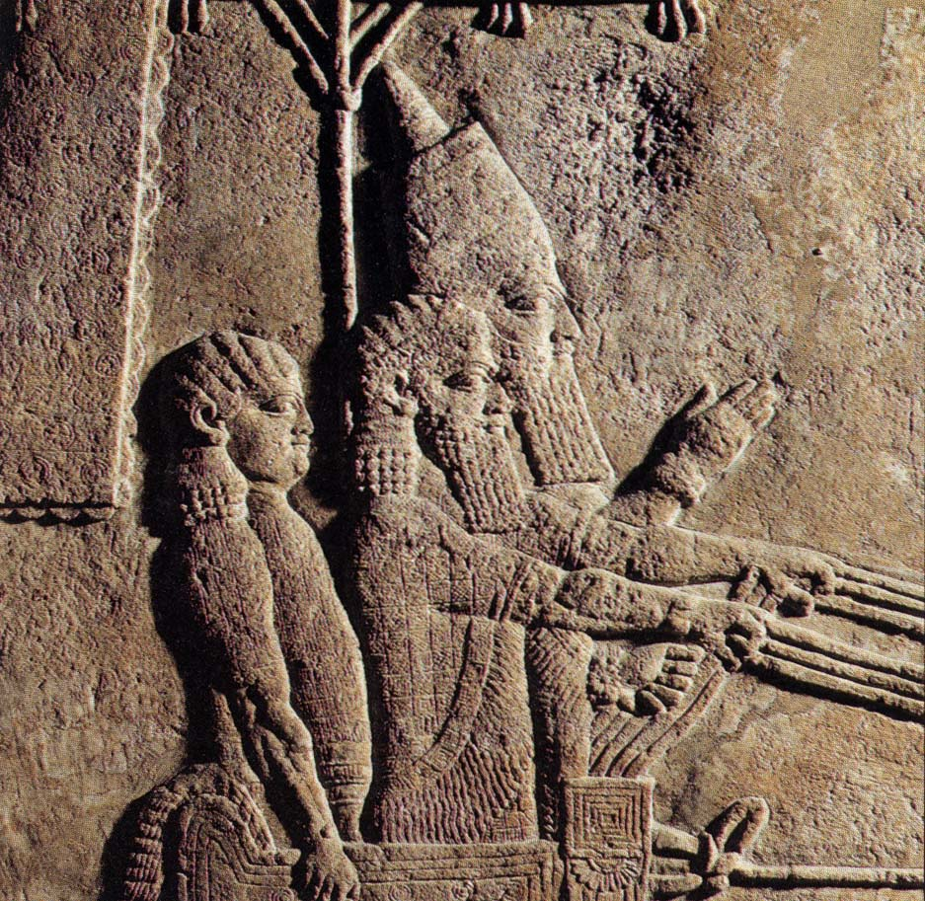
Capitals of the
Neo-Assyrian Empire ca. 900-600 BC
Sennacherib
(704-681 BC)
Notes:
Who were the Assyrians?
Founders of new cities in Northern Mesopotamia

Slide 30
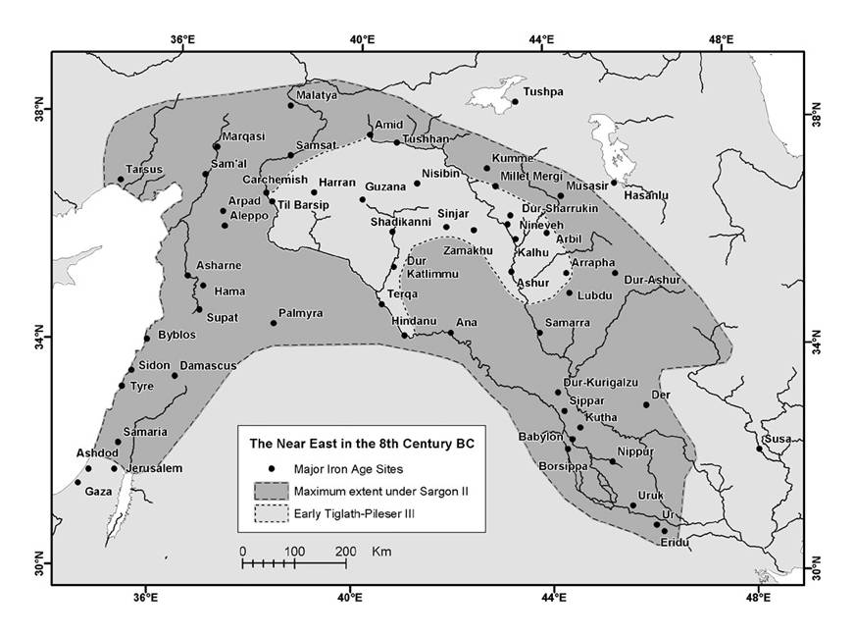
The Assyrian Empire,
900-700 BC
MEDIA
SOUTHERN
MESOPOTAMIA
From Wilkinson et al. 2005, based on Roaf 1990
Notes:
Expansionary polity

Slide 31
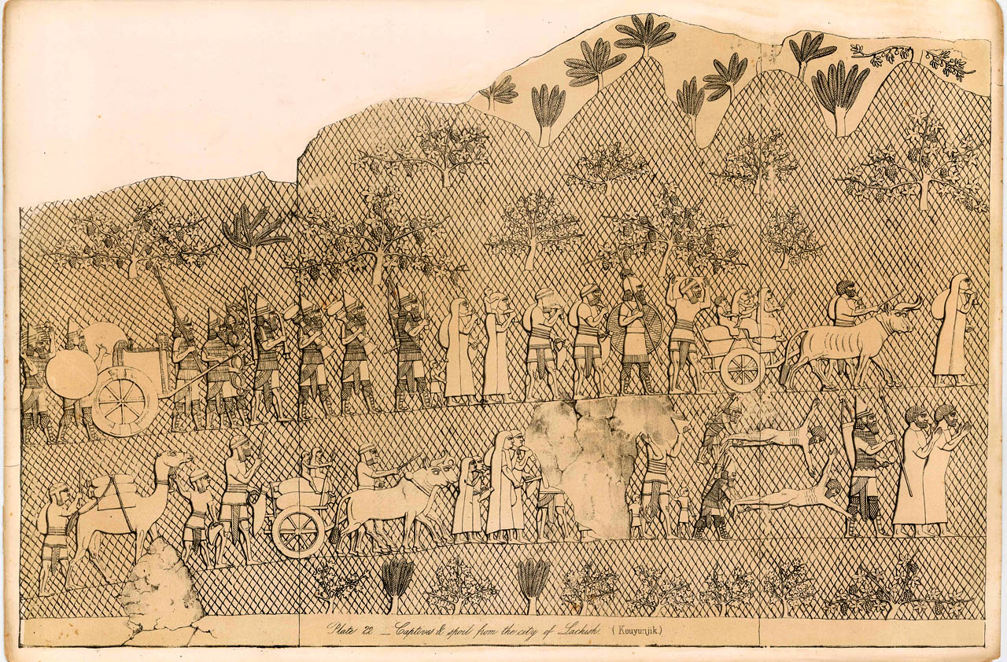
Assyrian Forced Migration of Conquered Peoples
From Layard, Monuments of Nineveh vol. I
Notes:
Forced migration of conquered peoples
But where did they go? Cities and countryside of Assyria

Slide 32
Nimrud
(ancient Kalkhu)

Slide 33
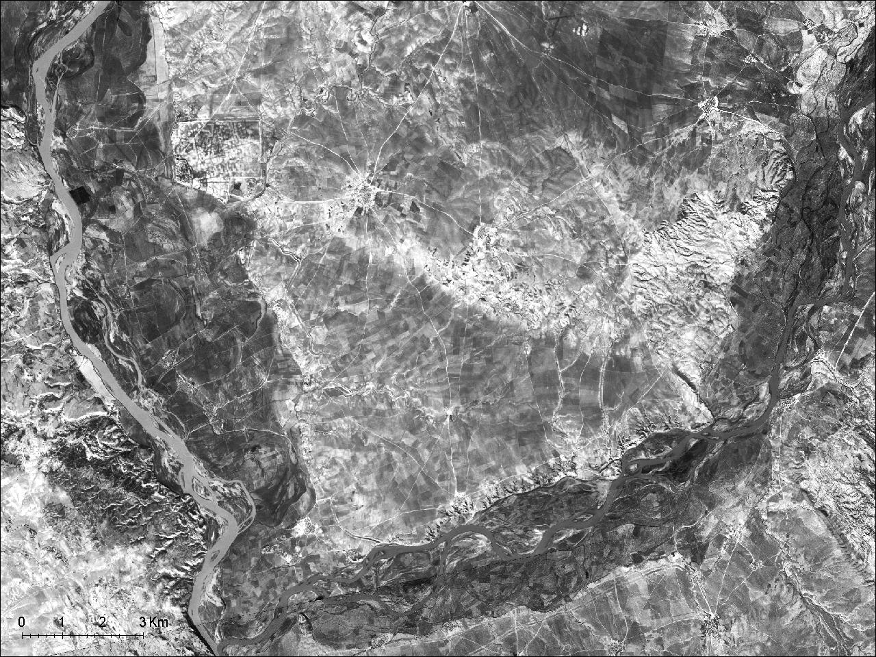
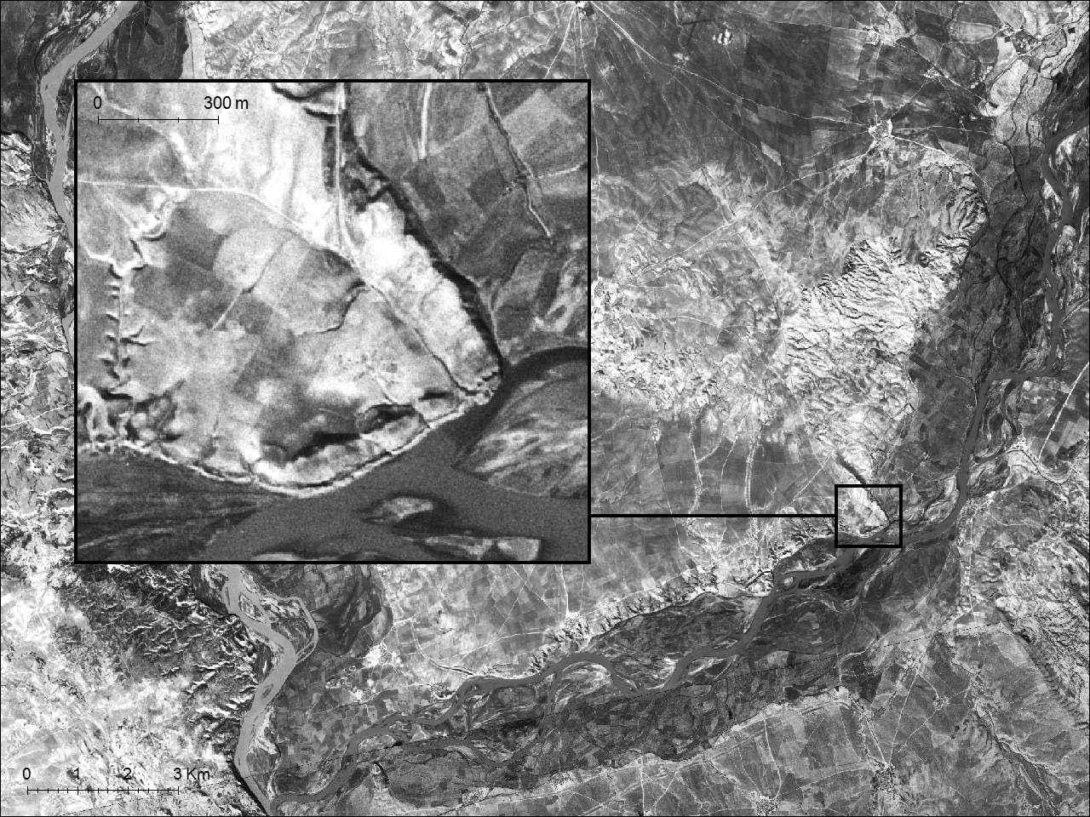
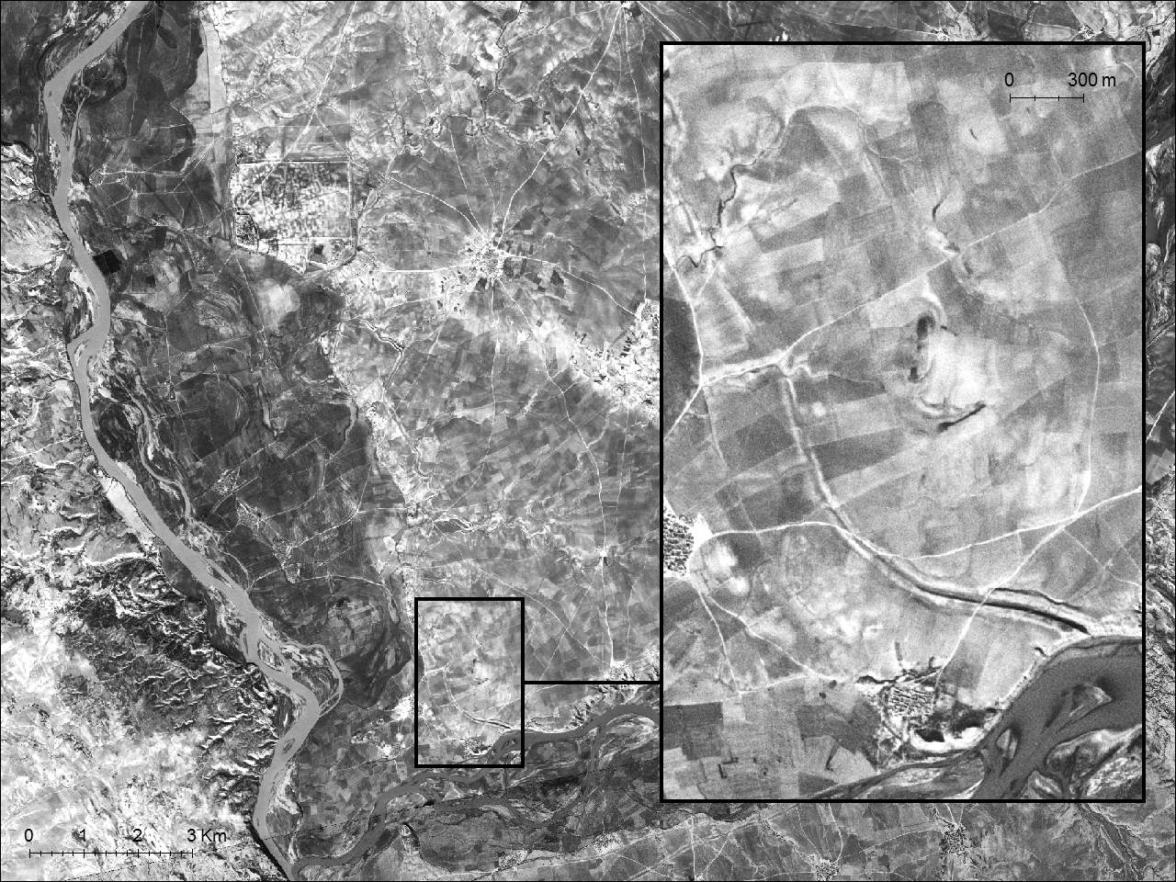
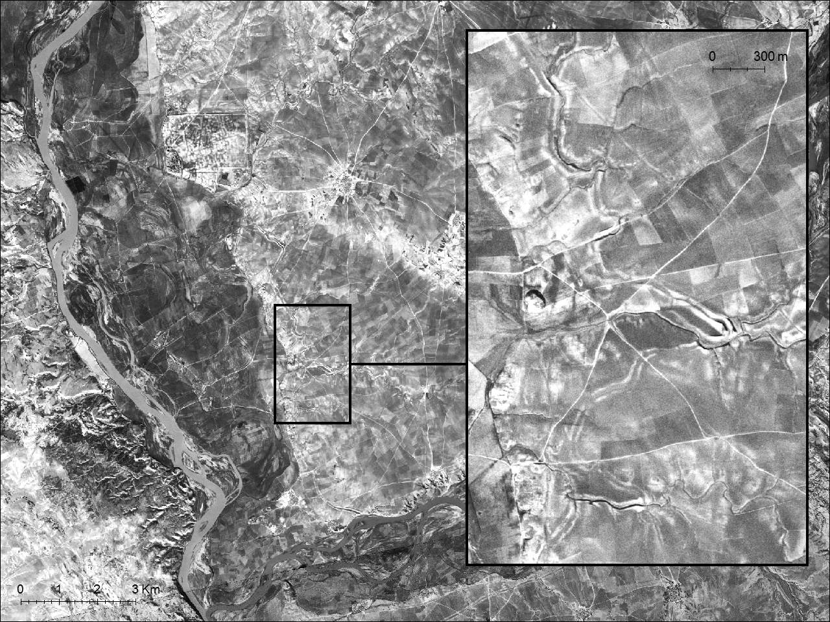
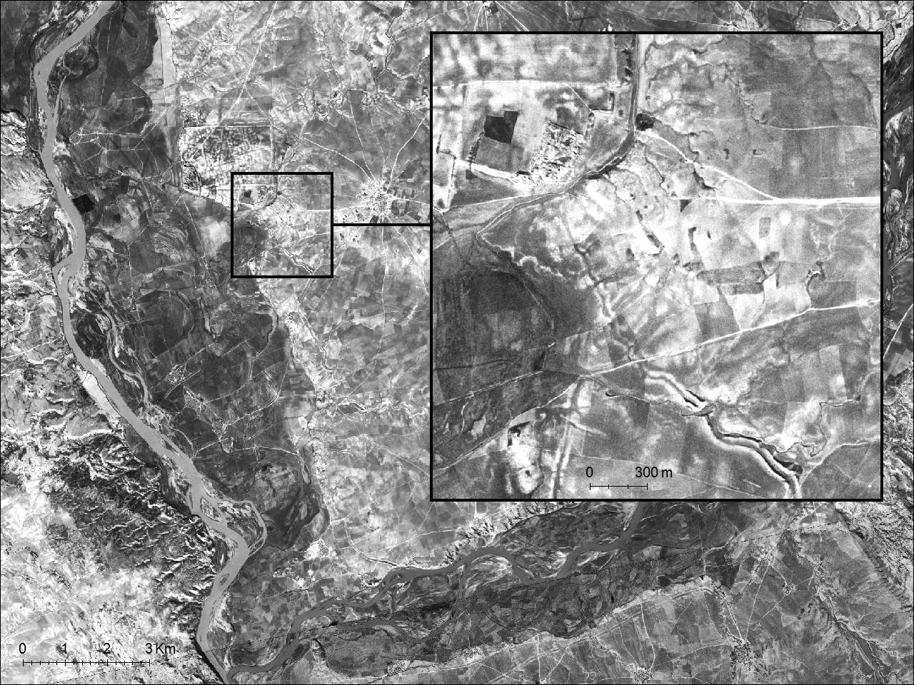
Water for Nimrud?
Local
Irrigation
Negub Tunnel
Conforming to Topography
Notes:
Situation of Nimrud, new capital
1. Canal Head, move water along Zab
2. Away from Zab toward Nimrud, with local irrigation
3. Following topography
4. Water possibly into city itself
Remarkable engineering accomplishment

Slide 34
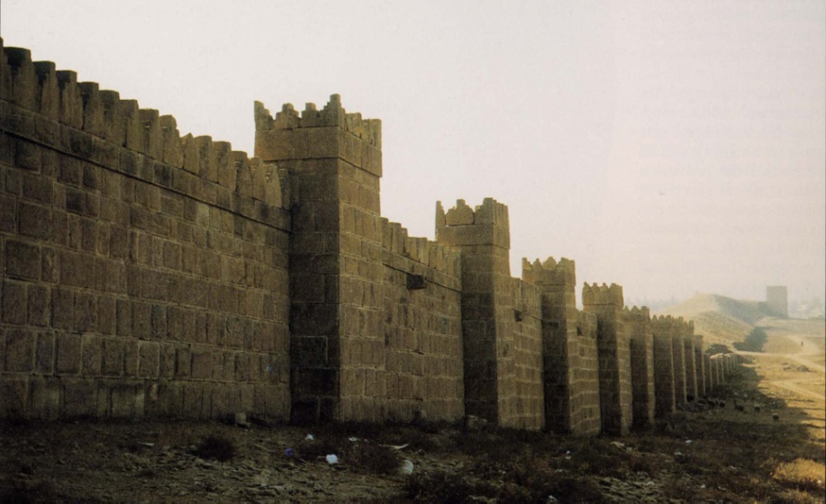
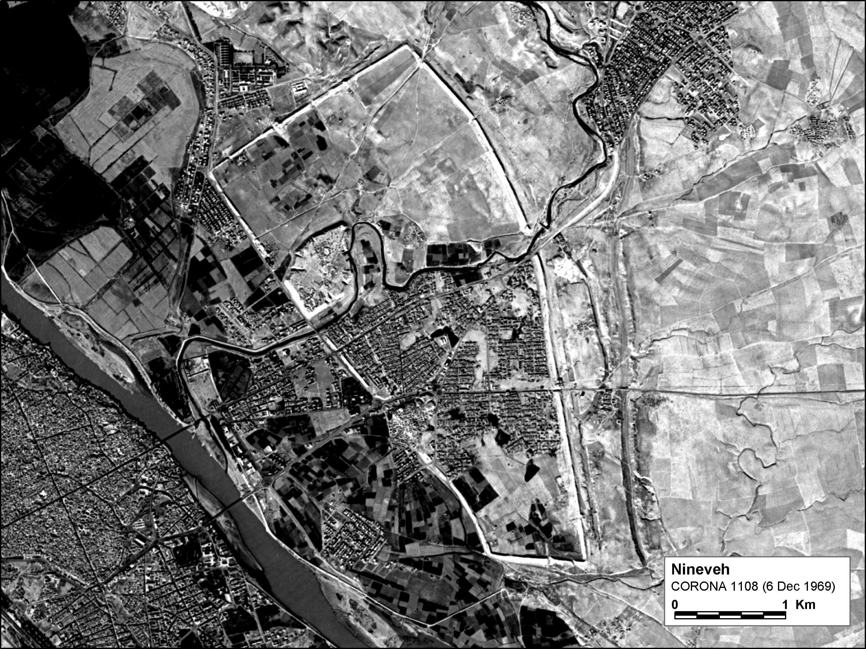
Nineveh (ca. 700 BC)
Notes:
Nimrud accomplishment surpassed by Nineveh, final capital ca. 700 BC

Slide 35
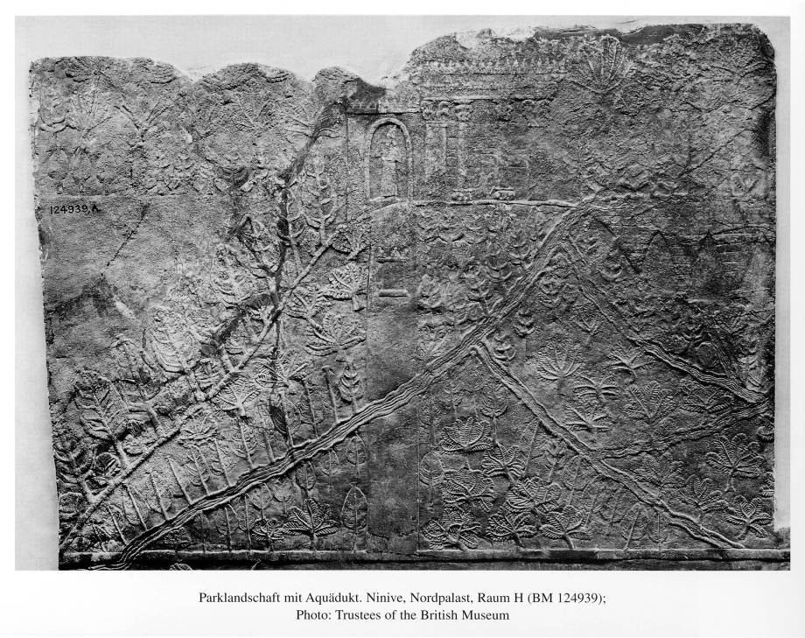
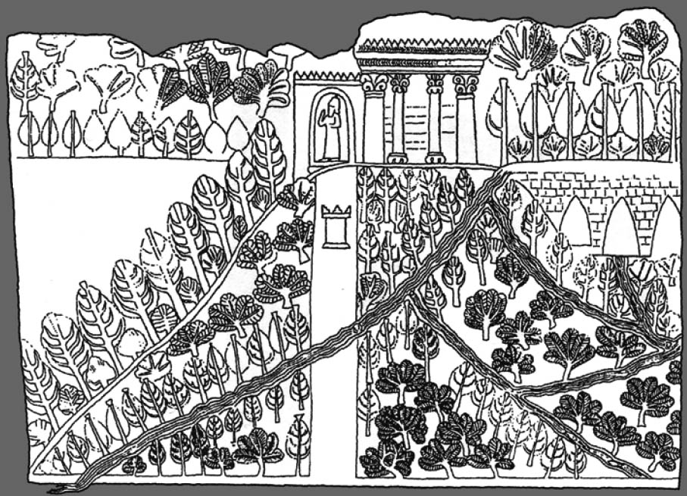
Notes:
Remarkable depiction from Asb palace

Slide 36
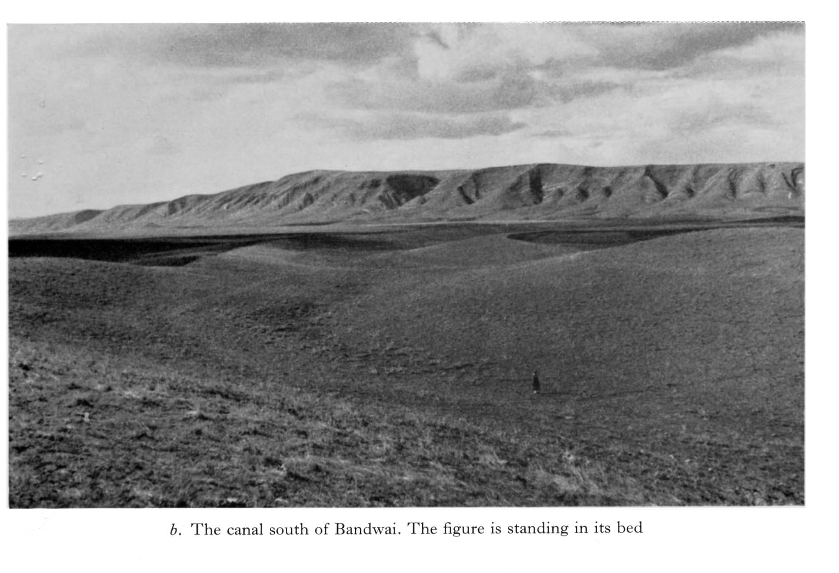
The Cross-Watershed Earthwork near Bandwai
Notes:
Arch primarily concerned with exc of major cities esp palaces
Field landsc observations anecdotal
Bandwai earthwork, D. Oates 1950’s

Slide 37
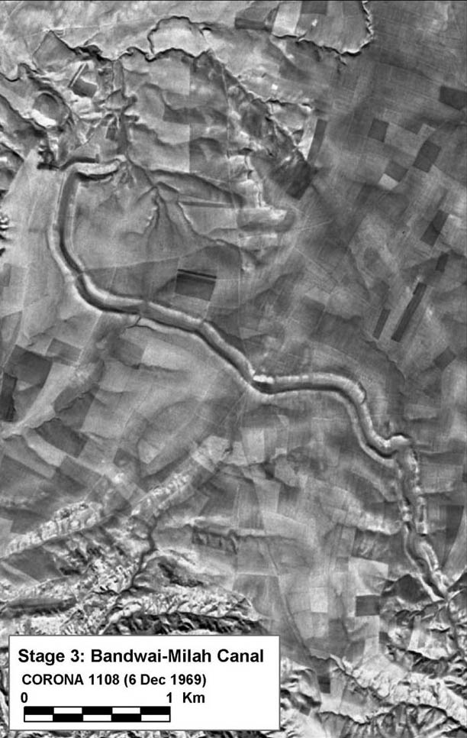
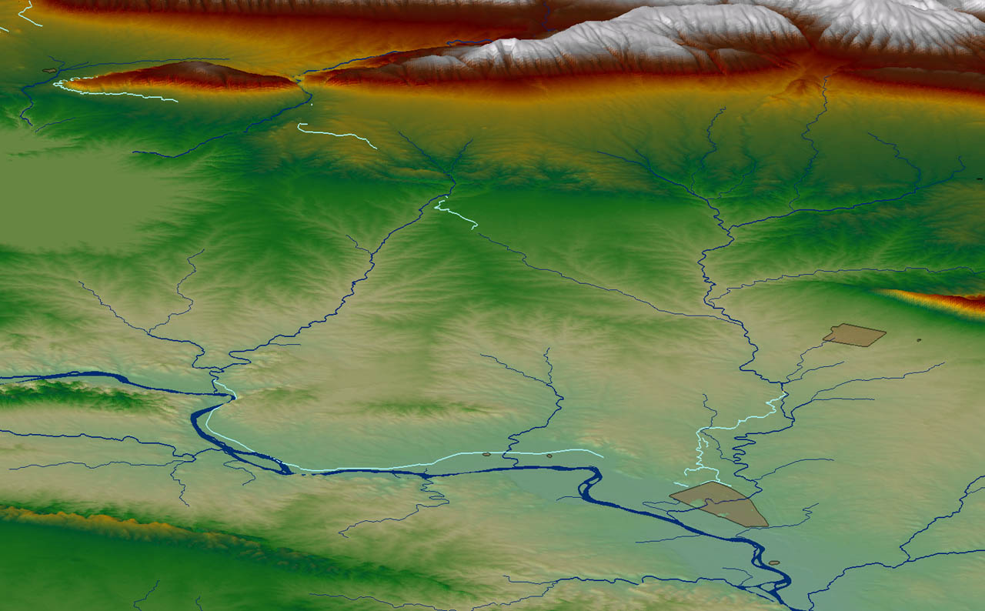
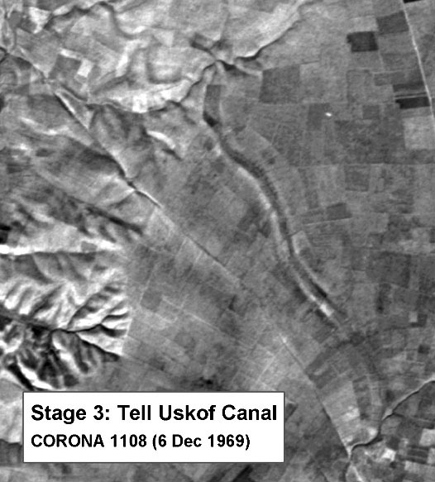
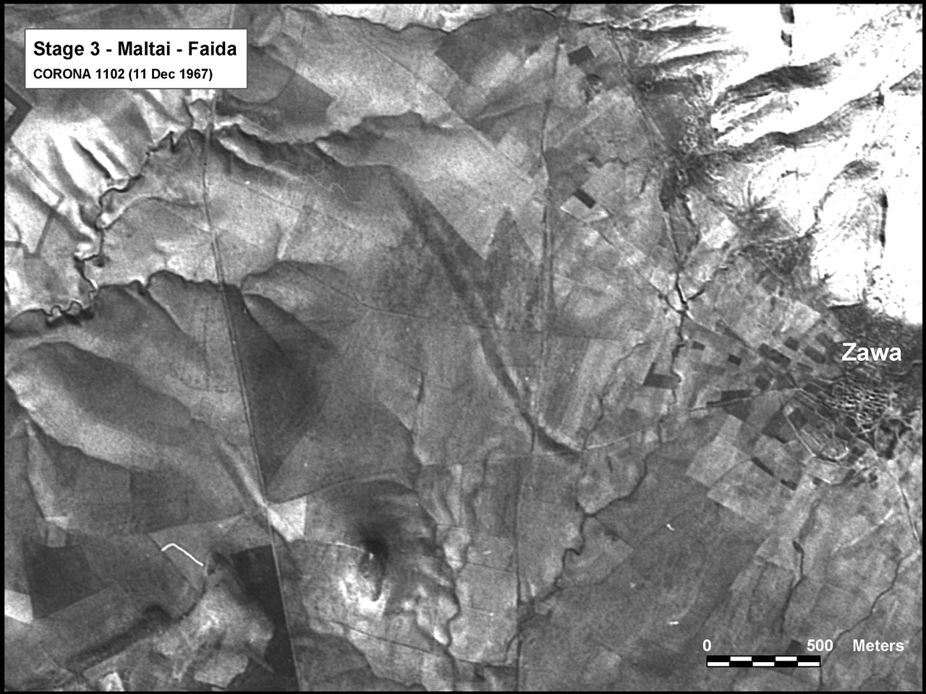
Sennacherib’s “Northern System”
Maltai Canal
Faida Canal
Bandwai Canal
Uskof Canal
Wadi Milah
Khosr River
Khorsabad
Kisiri Canal
Cross-Watershed
Earthwork
Dam at
al-Shallalat
Nineveh
Cross-Watershed
Earthwork
Notes:
Bandwai is clear; shows us the “signature”
We can then find it elsewhere: Maltai
Again near Tell Uskof

Slide 38
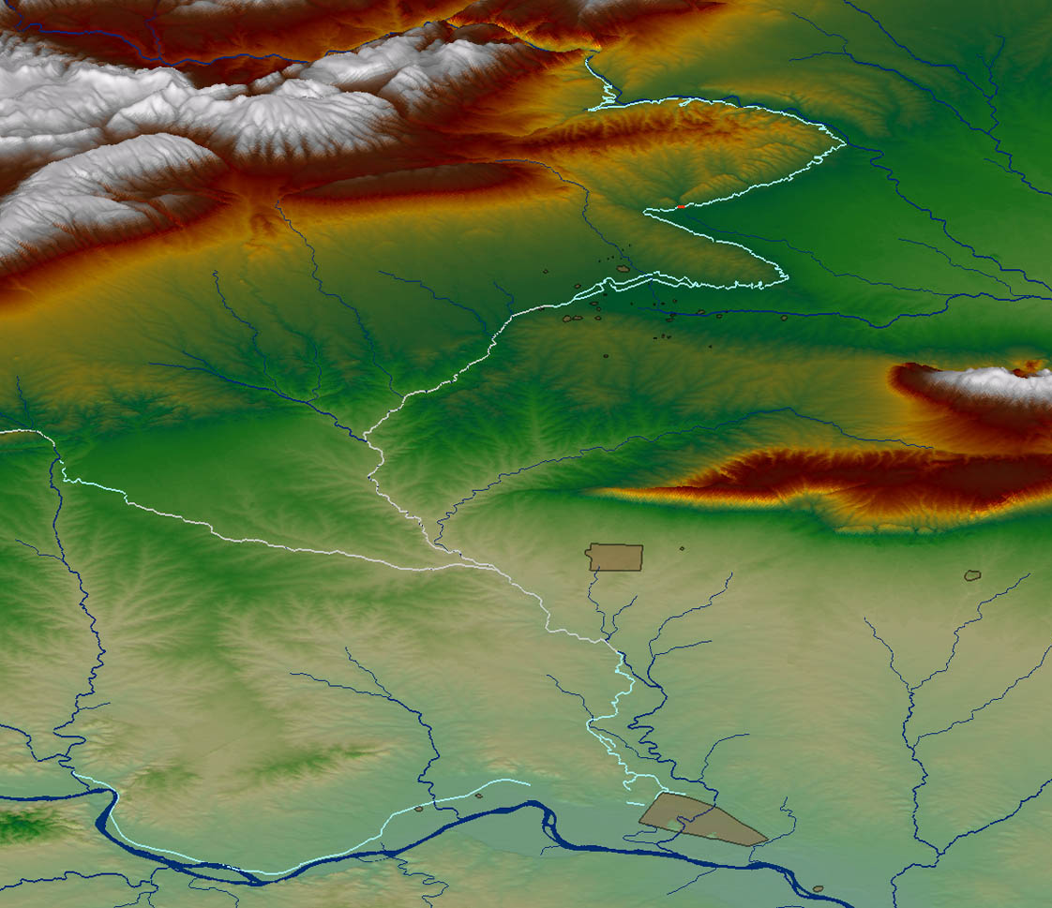
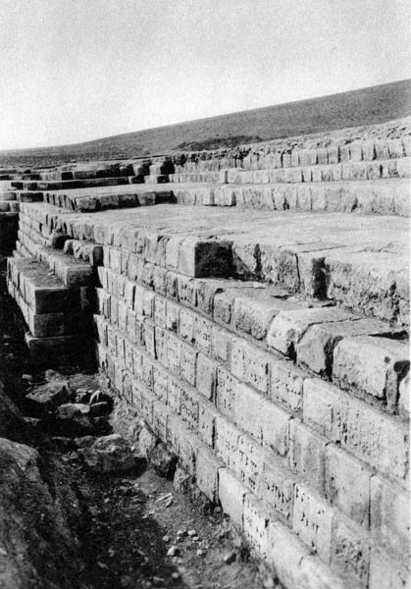
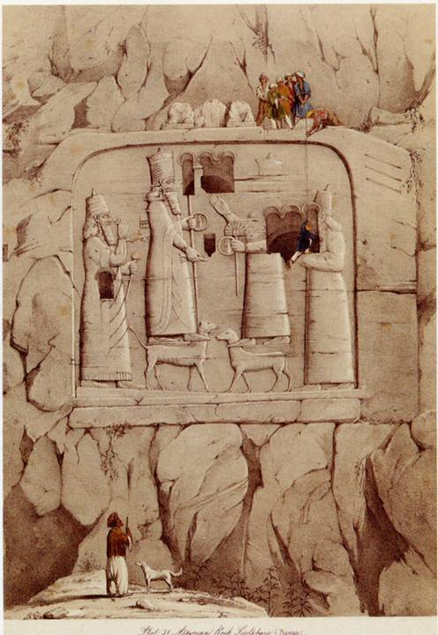
Canalhead at Khinis
Aqueduct at Jerwan
Dam at
al-Shallalat
Nineveh
Notes:
Turn to NE, Khinis System
Opportunistic visits, 1st by Layard in 1850
U of C in 1930’s at Jerwan aqueduct; reconstr system

Slide 39
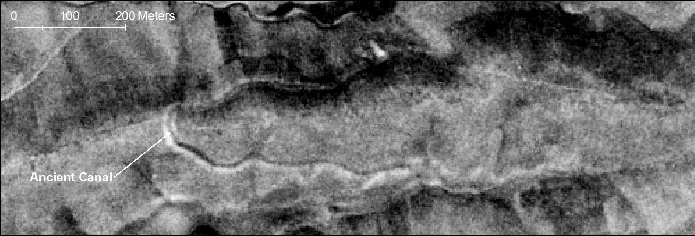

Ancient Canals near Bahrka
Satellite Image (1967)
View on Ground (2012)

Slide 40

The Collapse of Assyria

Slide 41

Qanat/Karez Irrigation

Slide 42


Ancient Karez
Satellite Image (1967)
View on Ground (2012)

Slide 43
Concluding Points
Water was always a critical element for early civilizations
…but with human ingenuity
Various levels of social organization

Slide 44
For more information, please contact:
Dr. Jason Ur
jasonur@fas.harvard.edu
http://www.fas.harvard.edu/~anthro/ur/

